Slide 1
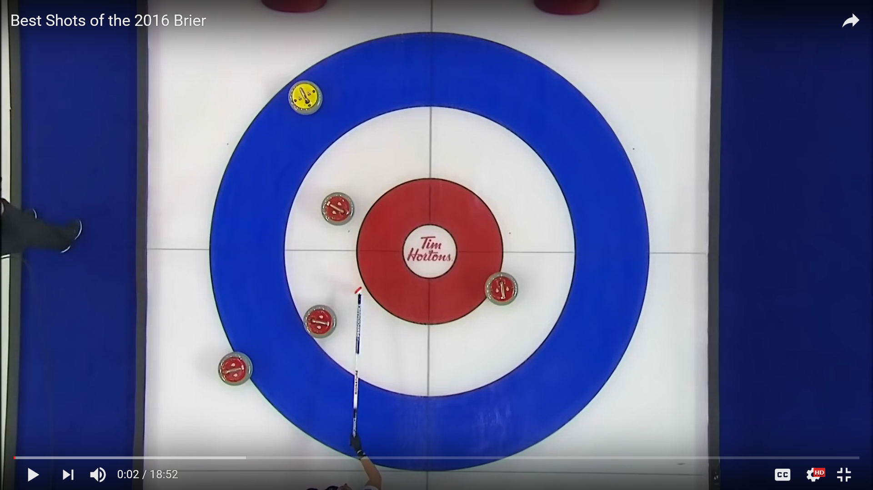
44th Wisconsin Junior Curling Championships
Going For The Deuce!
Portage Curling Club Dec. 16-18, 2016
Combined Event: U-18 and Wisconsin Junior!
All Juniors up to Age 21 Eligible
18-O Teams Play in Wisconsin Junior Only
U-18 Teams Play in Both Events
Entry Fee $160.00

Slide 2
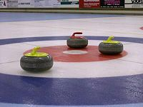
44th Wisconsin Junior Curling Championships
18 and Over Team Entry Form
Club:_____________________________
Name:____________________________ Birthday:_____________________________
Name:____________________________ Birthday:_____________________________
Name:____________________________ Birthday: _____________________________
Name:____________________________ Birthday:_____________________________
Alternate:________________________ Birthday:_____________________________
Coach (responsible adult)_______________ ENTRY FEE: $160
Contact Telephone:___________________ Entry Deadline: Nov. 30, 2016
Address:_____________________________
Please send payment and completed entry form to:
Mark Hartman (mhartma3@amfam.com)
227 Talon PL
Sun Prairie, WI 53590
Please note: U-18 teams sign up on www.USACURL.org.

