Slide 1
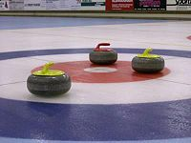
46th Wisconsin Junior Curling Championships
18 and Over Team Entry Form
Club:_____________________________
Name:____________________________ Birthday:_____________________________
Name:____________________________ Birthday:_____________________________
Name:____________________________ Birthday: _____________________________
Name:____________________________ Birthday:_____________________________
Alternate:________________________ Birthday:_____________________________
Coach (responsible adult)_______________ ENTRY FEE: $300
Contact Telephone:___________________ Entry Deadline: Nov. 30, 2018
Address:_____________________________
Please send payment and completed entry form to:
Mark Hartman (mhartma3@amfam.com)
227 Talon PL
Sun Prairie, WI 53590
Please note: U-18 teams sign up on www.USACURL.org.
Entry deadline for U-18: Nov. 21, 2018

