Slide 1
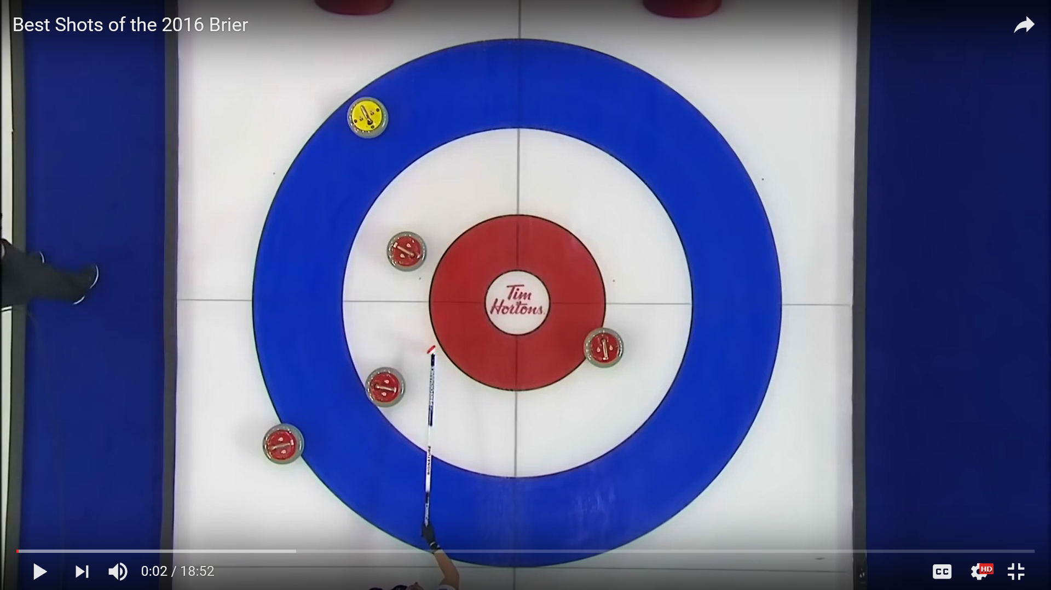
46th Wisconsin Junior Curling Championships
Going For The Deuce!
Wausau Curling Center Dec. 27-30, 2018
Combined Event: U-18 and Wisconsin Junior!
All Juniors up to Age 21 Eligible
18-O Teams Play in Wisconsin Junior Only
U-18 Teams Play in Both Events
Entry Fee $300.00

